Slide 1
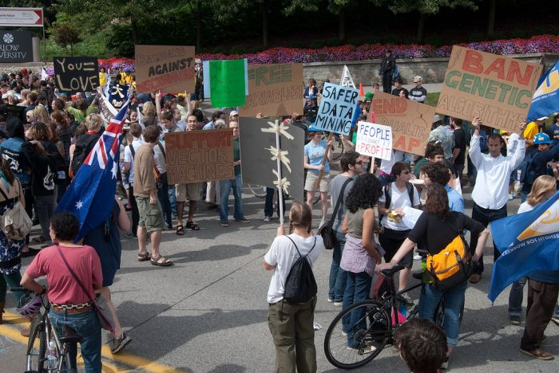
Machine Learning
Computer Vision
James Hays, Brown
Slides: Isabelle Guyon, Erik Sudderth, Mark Johnson, Derek Hoiem, Lana Lazebnik
Photo: CMU Machine Learning Department protests G20

Slide 2
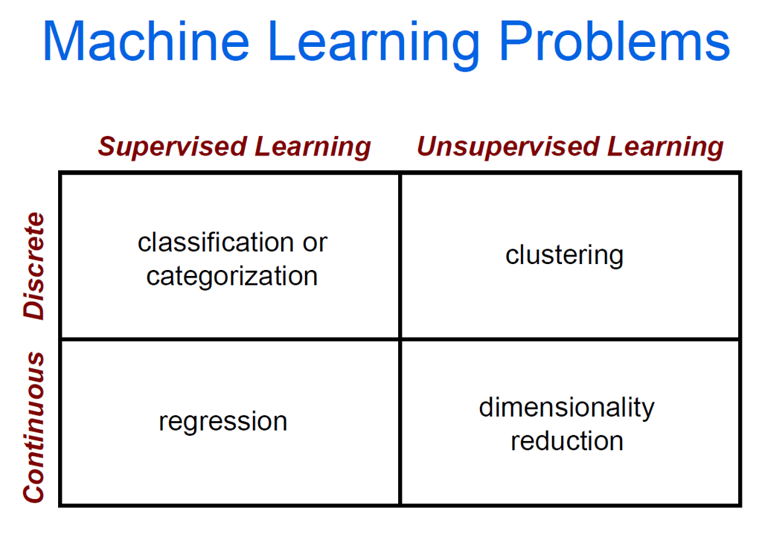

Slide 3
Clustering Strategies
K-means
Iteratively re-assign points to the nearest cluster center
Agglomerative clustering
Start with each point as its own cluster and iteratively merge the closest clusters
Mean-shift clustering
Estimate modes of pdf
Spectral clustering
Split the nodes in a graph based on assigned links with similarity weights
As we go down this chart, the clustering strategies have more tendency to transitively group points even if they are not nearby in feature space

Slide 5



The machine learning framework
Apply a prediction function to a feature representation of the image to get the desired output:
f( ) = “apple”
f( ) = “tomato”
f( ) = “cow”
Slide credit: L. Lazebnik

Slide 6
The machine learning framework
y = f(x)
Training: given a training set of labeled examples {(x₁,y₁), …, (x_{N},y_{N})}, estimate the prediction function f by minimizing the prediction error on the training set
Testing: apply f to a never before seen test example x and output the predicted value y = f(x)
output
prediction function
Image feature
Slide credit: L. Lazebnik

Slide 7
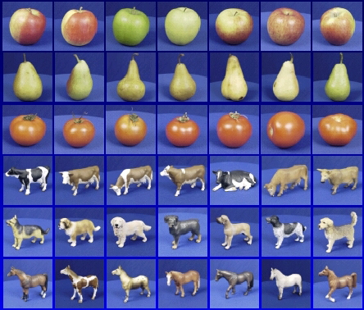

Steps
Training
Training Labels
Training Images
Image Features
Training
Learned model
Testing
Image Features
Learned model
Prediction
Test Image
Slide credit: D. Hoiem and L. Lazebnik

Slide 8
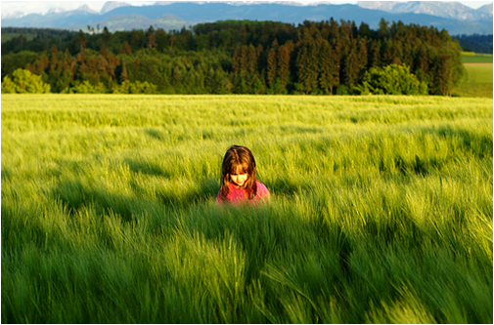
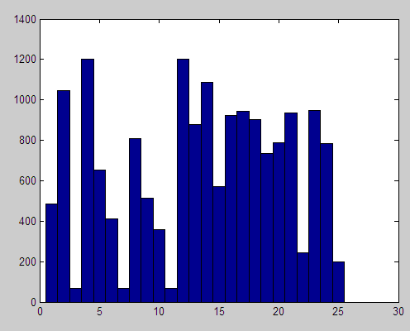
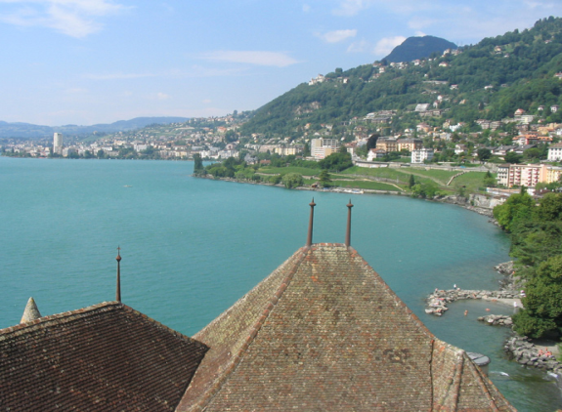
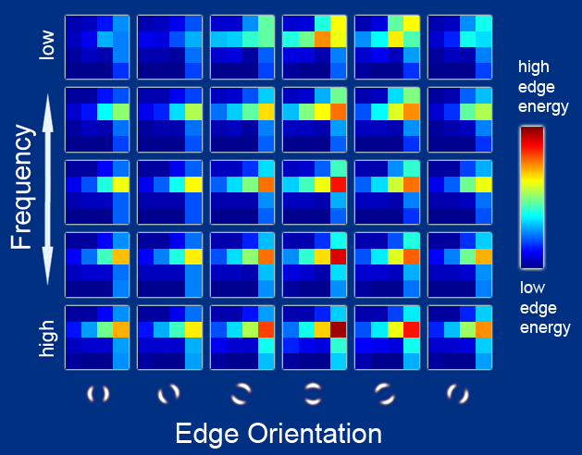
Features
Raw pixels
Histograms
GIST descriptors
…
Slide credit: L. Lazebnik

Slide 9
Classifiers: Nearest neighbor
Test example
Training examples from class 2
Training examples from class 1
f(x) = label of the training example nearest to x
All we need is a distance function for our inputs
No training required!
Slide credit: L. Lazebnik

Slide 10
Classifiers: Linear
Find a linear function to separate the classes:
f(x) = sgn(w ⋅ x + b)
Slide credit: L. Lazebnik

Slide 11
Many classifiers to choose from
SVM
Neural networks
Naïve Bayes
Bayesian network
Logistic regression
Randomized Forests
Boosted Decision Trees
K-nearest neighbor
RBMs
Etc.
Which is the best one?
Slide credit: D. Hoiem

Slide 12
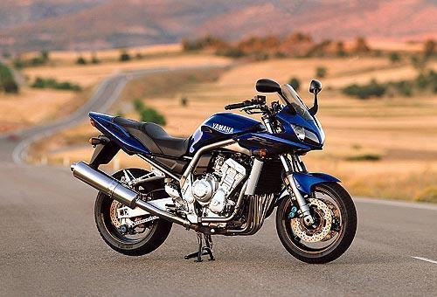
Recognition task and supervision
Images in the training set must be annotated with the “correct answer” that the model is expected to produce
Contains a motorbike
Slide credit: L. Lazebnik

Slide 13
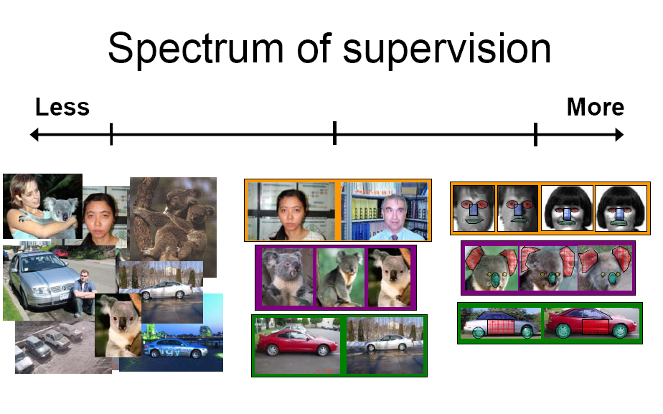
Unsupervised
“Weakly” supervised
Fully supervised
Definition depends on task
Slide credit: L. Lazebnik

Slide 14

Generalization
Training set (labels known)
Test set (labels unknown)
How well does a learned model generalize from the data it was trained on to a new test set?
Slide credit: L. Lazebnik

Slide 15
Generalization
Components of generalization error
Bias: how much the average model over all training sets differ from the true model?
Error due to inaccurate assumptions/simplifications made by the model
Variance: how much models estimated from different training sets differ from each other
Underfitting: model is too “simple” to represent all the relevant class characteristics
High bias and low variance
High training error and high test error
Overfitting: model is too “complex” and fits irrelevant characteristics (noise) in the data
Low bias and high variance
Low training error and high test error
Slide credit: L. Lazebnik

Slide 16
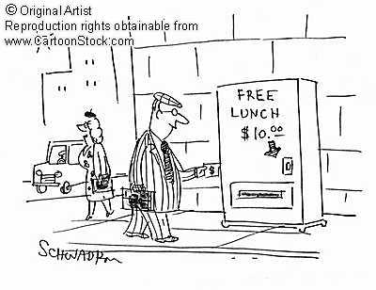
No Free Lunch Theorem
Slide credit: D. Hoiem
Notes:
You can only get generalization through assumptions.

Slide 17
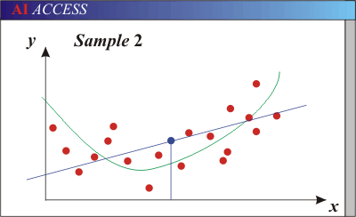
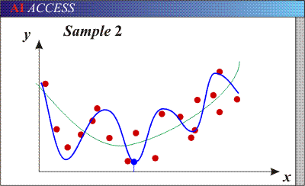
Bias-Variance Trade-off
Models with too few parameters are inaccurate because of a large bias (not enough flexibility).
Models with too many parameters are inaccurate because of a large variance (too much sensitivity to the sample).
Slide credit: D. Hoiem
Notes:
http://www.aiaccess.net/English/Glossaries/GlosMod/e_gm_bias_variance.htm

Slide 18
Bias-Variance Trade-off
E(MSE) = noise² + bias² + variance
Error due to variance of training samples
Unavoidable error
Error due to incorrect assumptions
See the following for explanations of bias-variance (also Bishop’s “Neural Networks” book):
http://www.inf.ed.ac.uk/teaching/courses/mlsc/Notes/Lecture4/BiasVariance.pdf
Slide credit: D. Hoiem
Notes:
From the link above:
You can only get generalization through assumptions.
Thus in order to minimize the MSE, we need to minimize both
the bias and the variance. However, this is not trivial to do this. For instance, just
neglecting the input data and predicting the output somehow (e.g., just a constant), would definitely minimize the variance of our predictions: they would be
always the same, thus the variance would be zero—but the bias of our estimate
(i.e., the amount we are off the real function) would be tremendously large. On
the other hand, the neural network could perfectly interpolate the training data,
i.e., it predict y=t for every data point. This will make the bias term vanish entirely, since the E(y)=f (insert this above into the squared bias term to verify this),
but the variance term will become equal to the variance of the noise, which may
be significant (see also Bishop Chapter 9 and the Geman et al. Paper). In general,
finding an optimal bias-variance tradeoff is hard, but acceptable solutions can be
found, e.g., by means of cross validation or regularization.

Slide 19
Bias-variance tradeoff
Underfitting
Overfitting
Error
Test error
Training error
High Bias
Low Variance
Complexity
Low Bias
High Variance
Slide credit: D. Hoiem

Slide 20
Bias-variance tradeoff
Few training examples
Test Error
Many training examples
High Bias
Low Variance
Complexity
Low Bias
High Variance
Slide credit: D. Hoiem
Notes:
Note: these figures don’t work in pdf

Slide 21
Effect of Training Size
Fixed prediction model
Error
Testing
Generalization Error
Training
Number of Training Examples
Slide credit: D. Hoiem

Slide 22
The perfect classification algorithm
Objective function: encodes the right loss for the problem
Parameterization: makes assumptions that fit the problem
Regularization: right level of regularization for amount of training data
Training algorithm: can find parameters that maximize objective on training set
Inference algorithm: can solve for objective function in evaluation
Slide credit: D. Hoiem

Slide 23
Remember…
No classifier is inherently better than any other: you need to make assumptions to generalize
Three kinds of error
Inherent: unavoidable
Bias: due to over-simplifications
Variance: due to inability to perfectly estimate parameters from limited data
Slide credit: D. Hoiem
Slide credit: D. Hoiem
Notes:
You can only get generalization through assumptions.

Slide 24
How to reduce variance?
Choose a simpler classifier
Regularize the parameters
Get more training data
Slide credit: D. Hoiem
Notes:
The simpler classifier or regularization could increase bias and lead to more error.

Slide 25
Very brief tour of some classifiers
K-nearest neighbor
SVM
Boosted Decision Trees
Neural networks
Naïve Bayes
Bayesian network
Logistic regression
Randomized Forests
RBMs
Etc.

Slide 26
Generative vs. Discriminative Classifiers
Generative Models
Represent both the data and the labels
Often, makes use of conditional independence and priors
Examples
Naïve Bayes classifier
Bayesian network
Models of data may apply to future prediction problems
Discriminative Models
Learn to directly predict the labels from the data
Often, assume a simple boundary (e.g., linear)
Examples
Logistic regression
SVM
Boosted decision trees
Often easier to predict a label from the data than to model the data
Slide credit: D. Hoiem
Notes:
Generative classifiers try to model the data. Discriminative classifiers try to predict the label.

Slide 27
Classification
Assign input vector to one of two or more classes
Any decision rule divides input space into decision regions separated by decision boundaries
Slide credit: L. Lazebnik

Slide 28
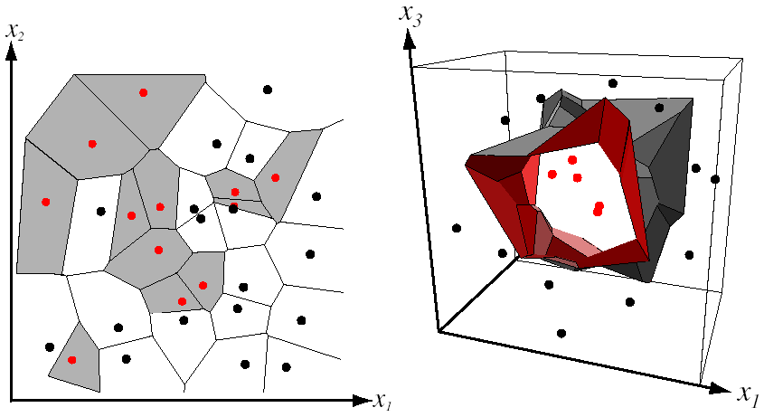
Nearest Neighbor Classifier
Assign label of nearest training data point to each test data point
from Duda et al.
Voronoi partitioning of feature space
for two-category 2D and 3D data
Source: D. Lowe

Slide 29
K-nearest neighbor
x
x
x
o
x
x
x
+
o
o
x
x
o
o
+
o
o
x2
x1

Slide 30
1-nearest neighbor
x
x
x
o
x
x
x
+
o
o
x
x
o
o
+
o
o
x2
x1

Slide 31
3-nearest neighbor
x
x
x
o
x
x
x
+
o
o
x
x
o
o
+
o
o
x2
x1

Slide 32
5-nearest neighbor
x
x
x
o
x
x
x
+
o
o
x
x
o
o
+
o
o
x2
x1

Slide 33
Using K-NN
Simple, a good one to try first
With infinite examples, 1-NN provably has error that is at most twice Bayes optimal error

Slide 34
Naïve Bayes
y
x₁
x₂
x₃

Slide 35
Using Naïve Bayes
Simple thing to try for categorical data
Very fast to train/test

Slide 36
Classifiers: Logistic Regression
Maximize likelihood of label given data, assuming a log-linear model
x
x
x
x
x
x
male
o
x
x
o
o
Height
o
female
o
x2
x1
Pitch of voice

Slide 37
Using Logistic Regression
Quick, simple classifier (try it first)
Outputs a probabilistic label confidence
Use L2 or L1 regularization
L1 does feature selection and is robust to irrelevant features but slower to train

Slide 38
Classifiers: Linear SVM
x
x
x
x
x
x
o
x
x
o
o
o
o
x2
x1
Find a linear function to separate the classes:
f(x) = sgn(w ⋅ x + b)

Slide 39
Classifiers: Linear SVM
x
x
x
x
x
x
o
x
x
o
o
o
o
x2
x1
Find a linear function to separate the classes:
f(x) = sgn(w ⋅ x + b)
Notes:
Maximizes a margin

Slide 40
Classifiers: Linear SVM
x
x
x
o
x
x
x
o
x
x
o
o
o
o
x2
x1
Find a linear function to separate the classes:
f(x) = sgn(w ⋅ x + b)

Slide 41
Nonlinear SVMs
Datasets that are linearly separable work out great:
But what if the dataset is just too hard?
We can map it to a higher-dimensional space:
0
x
0
x
x²
0
x
Slide credit: Andrew Moore

Slide 42
Nonlinear SVMs
General idea: the original input space can always be mapped to some higher-dimensional feature space where the training set is separable:
Φ: x → φ(x)
Slide credit: Andrew Moore

Slide 43
Nonlinear SVMs
The kernel trick: instead of explicitly computing the lifting transformation φ(x), define a kernel function K such that K(x_{i} , x_{j}) = φ(x_{i} ) · φ(x_{j})
(to be valid, the kernel function must satisfy Mercer’s condition)
This gives a nonlinear decision boundary in the original feature space:
C. Burges, A Tutorial on Support Vector Machines for Pattern Recognition, Data Mining and Knowledge Discovery, 1998

Slide 44
Nonlinear kernel: Example
Consider the mapping
x²

Slide 45
Kernels for bags of features
Histogram intersection kernel:
Generalized Gaussian kernel:
D can be (inverse) L1 distance, Euclidean distance, χ² distance, etc.
J. Zhang, M. Marszalek, S. Lazebnik, and C. Schmid, Local Features and Kernels for Classifcation of Texture and Object Categories: A Comprehensive Study, IJCV 2007

Slide 46
Summary: SVMs for image classification
Pick an image representation (in our case, bag of features)
Pick a kernel function for that representation
Compute the matrix of kernel values between every pair of training examples
Feed the kernel matrix into your favorite SVM solver to obtain support vectors and weights
At test time: compute kernel values for your test example and each support vector, and combine them with the learned weights to get the value of the decision function
Slide credit: L. Lazebnik

Slide 47
What about multi-class SVMs?
Unfortunately, there is no “definitive” multi-class SVM formulation
In practice, we have to obtain a multi-class SVM by combining multiple two-class SVMs
One vs. others
Traning: learn an SVM for each class vs. the others
Testing: apply each SVM to test example and assign to it the class of the SVM that returns the highest decision value
One vs. one
Training: learn an SVM for each pair of classes
Testing: each learned SVM “votes” for a class to assign to the test example
Slide credit: L. Lazebnik

Slide 48
SVMs: Pros and cons
Pros
Many publicly available SVM packages: http://www.kernel-machines.org/software
Kernel-based framework is very powerful, flexible
SVMs work very well in practice, even with very small training sample sizes
Cons
No “direct” multi-class SVM, must combine two-class SVMs
Computation, memory
During training time, must compute matrix of kernel values for every pair of examples
Learning can take a very long time for large-scale problems

Slide 49
Summary: Classifiers
Nearest-neighbor and k-nearest-neighbor classifiers
L1 distance, χ² distance, quadratic distance, histogram intersection
Support vector machines
Linear classifiers
Margin maximization
The kernel trick
Kernel functions: histogram intersection, generalized Gaussian, pyramid match
Multi-class
Of course, there are many other classifiers out there
Neural networks, boosting, decision trees, …
Slide credit: L. Lazebnik

Slide 50
Classifiers: Decision Trees
x
x
x
o
x
x
x
o
x
o
x
o
o
o
o
x2
x1

Slide 51
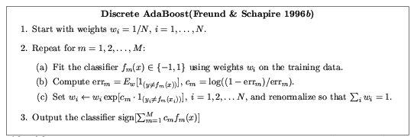
Ensemble Methods: Boosting
figure from Friedman et al. 2000

Slide 52
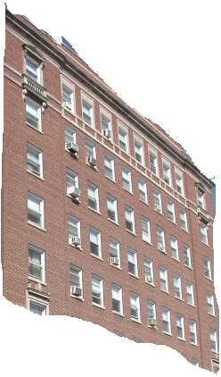
Boosted Decision Trees
High in
Image?
Gray?
Yes
No
Yes
No
Smooth?
Green?
High in
Image?
Many Long
Lines?
…
Yes
No
Yes
No
Yes
No
Yes
No
Blue?
Very High
Vanishing
Point?
Yes
No
Yes
No
Ground Vertical Sky
P(label | good segment, data)
[Collins et al. 2002]

Slide 53
Using Boosted Decision Trees
Flexible: can deal with both continuous and categorical variables
How to control bias/variance trade-off
Size of trees
Number of trees
Boosting trees often works best with a small number of well-designed features
Boosting “stubs” can give a fast classifier

Slide 54
Ideals for a classification algorithm
Objective function: encodes the right loss for the problem
Parameterization: takes advantage of the structure of the problem
Regularization: good priors on the parameters
Training algorithm: can find parameters that maximize objective on training set
Inference algorithm: can solve for labels that maximize objective function for a test example

Slide 55
Two ways to think about classifiers
What is the objective? What are the parameters? How are the parameters learned? How is the learning regularized? How is inference performed?
How is the data modeled? How is similarity defined? What is the shape of the boundary?
Slide credit: D. Hoiem

Slide 56
Comparison
assuming x in {0 1}
Learning Objective
Training
Inference
Naïve Bayes
Logistic Regression
Gradient ascent
Linear SVM
Linear programming
Kernelized SVM
complicated to write
Quadratic programming
Nearest Neighbor
most similar features → same label
Record data
Slide credit: D. Hoiem

Slide 57
What to remember about classifiers
No free lunch: machine learning algorithms are tools, not dogmas
Try simple classifiers first
Better to have smart features and simple classifiers than simple features and smart classifiers
Use increasingly powerful classifiers with more training data (bias-variance tradeoff)
Slide credit: D. Hoiem

Slide 58
Some Machine Learning References
General
Tom Mitchell, Machine Learning, McGraw Hill, 1997
Christopher Bishop, Neural Networks for Pattern Recognition, Oxford University Press, 1995
Adaboost
Friedman, Hastie, and Tibshirani, “Additive logistic regression: a statistical view of boosting”, Annals of Statistics, 2000
SVMs
http://www.support-vector.net/icml-tutorial.pdf
Slide credit: D. Hoiem

